Slide 1
HTTP VS HTTPS
By: Jacob Steele

Slide 2
What is HTTP?
HTTP = Hypertext Transfer Protocol
Is the foundation for the World Wide Web
Most common version of HTTP is HTTP/1.1
  Defined in RFC 2616 in 1999
Is part of the application layer
  Used for distributed collaborative hypermedia information systems
Used to exchange or transfer hypertext
  Is structured text, uses logical links between nodes containing text
Defines how messages are formatted and transmitted over the internet
Notes:
<number>

Slide 3
How HTTP Works
Is a request/response protocol
  Request: client sends request to the server
  Response: server sends response back
Usually takes place over TCP/IP connections
  Default port is TCP 80
Most HTTP communication is initiated by a user agent
  Simplest case is accomplished by a single connection
Notes:
-client sends a request to the server in form of a request method, URL and protocol version, followed by a MIME-like message containing request modifiers, client information, and possible body content over a connection with a server
-server responds with a status line, including message’s protocol version, and success or error code, followed by a MIME-like message containing server info, entity metainformation, and possible entity-body content.
<number>

Slide 4
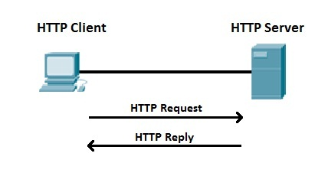
Simple HTTP Operation
request chain ------------------------>
User agent -------------------v-------------------------- Origin server
<----------------------- response chain
Notes:
-simplest case which may be accomplished by a single connection (v) between the user agent and the origin server.
-Client initiates a request by establishing a TCP connection to a particular port on a server. An HTTP server listening on that port waits for the client’s request message.
-Upon receiving the request, the server sends back a status line, such as “HTTP/1.1 200 OK”, and a message of its own.
-the body of this message is typically the requested resource, although an error message or other information may be returned
<number>

Slide 5
Types of HTTP Requests
Notes:
GET: requests a representation of the specified resource.
-Requests using get should only retrieve data and should have no other effect
HEAD: Asks for a response identical to that of the GET request, but without the response body
-useful for retrieving meta-info written in headers
POST: requests that the server accept the entity enclosed in the request
-Data posted may be an annotation, a message, a block of data that is being submitted to a webform etc.
PUT: requests that some file be sent from the server to the client
TRACE: echoes the received request so that a client can see what (if any_ changes or additions have been made by intermediate servers
CONNECT: converts the request connection to a transparent TCP/IP tunnel, usually to facilitate SSL encrypted commination through an unencrypted HTTP proxy
OPTION: returns the HTTP method that the server supports for the specified URL
<number>

Slide 6
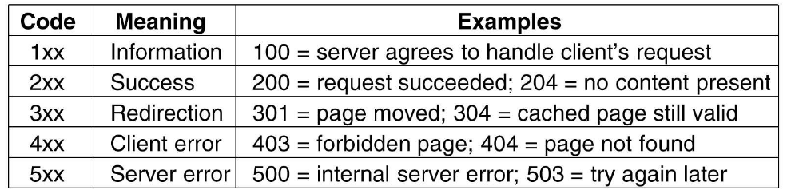
HTTP Status Codes
Notes:
1xx: class of status code indicates a provisional response, consisting only of the status-line and optional headers
-HTTP/1.0 did not define any 1xx status codes, servers must not send a 1xx response to an HTTP/1.0 client
100 (Continue): means that the server has received the request headers and that the client should proceed to send the request body
2xx: class of status codes indicates the action requested by the client was received, understood and accepted and processed successfully
3xx: class of status codes indicates the client must take additional action to complete the request
-Many of these codes are used in URL redirection
4xx: class of status code intended for cases In which the client seems to have errored
5xx: Server failed to fulfill an apparently valid request
<number>

Slide 7
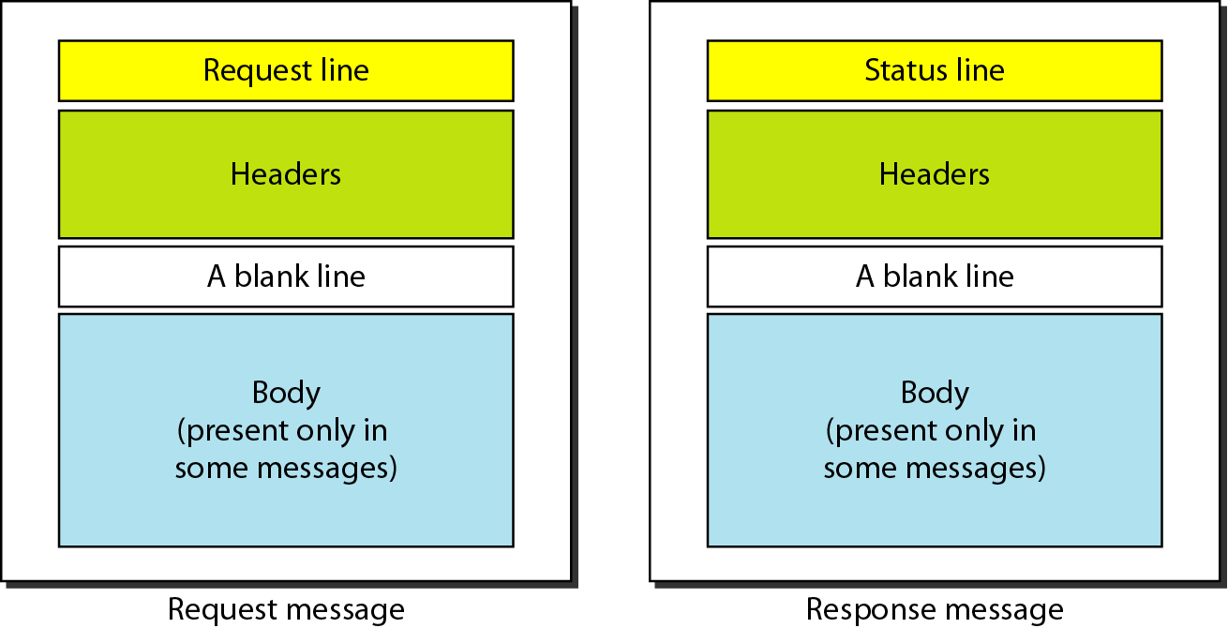
HTTP Request/Response Messages
Notes:
<number>

Slide 8
HTTP GET Example

Slide 9
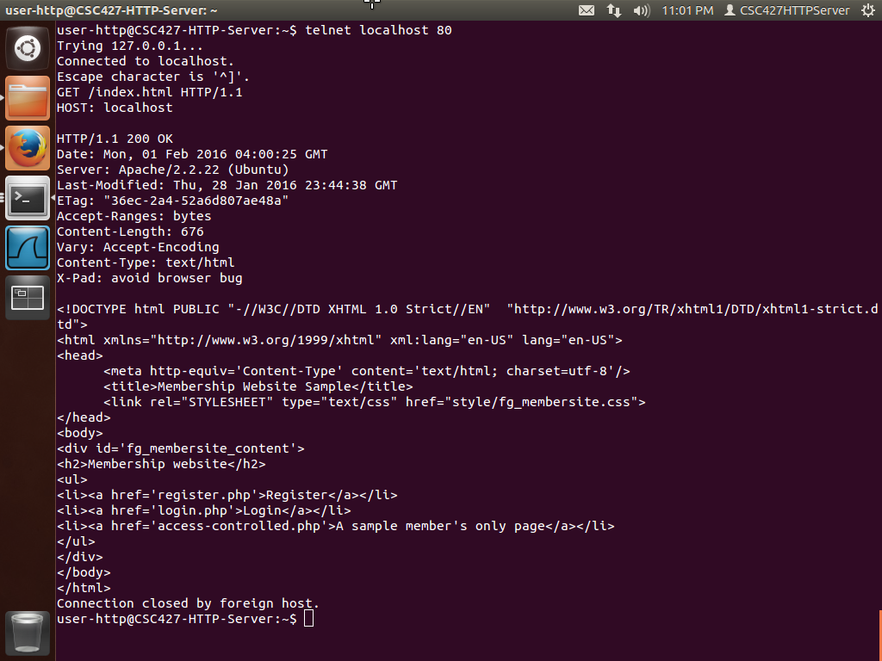
Notes:
ETag: An identifier for a specific version of a resource, often a message digest
Accept-Ranges: What partial content range types this server supports
Content-Length: The length of the response body in octets
telnet localhost 80
GET /index.html HTTP/1.1
HOST: localhost
<number>

Slide 10
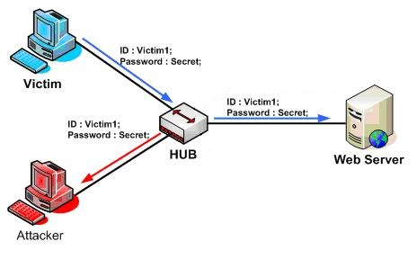
Security in HTTP
There isn’t much security when it comes to HTTP
Data sent back and forth is unencrypted
  This leaves data open to man-in-middle attacks
DNS Spoofing
Notes:
-Because of the way the application works, all data is sent back and forth as unencrypted
-This means an attacker could potentially sniff the packets and grab sensitive info
When a network device called a HUB is used on the Local Area Network topology, the Network Eavesdropping become easier because the device repeats all traffic received on one port to all other ports. Using a protocol analyzer, the attacker can capture all traffic on the LAN discovering sensitive information.
Since clients using HTTP rely heavily on DNS are more prone to security based on deliberate miss-association of IP addresses and DNS names
<number>

Slide 11

Quick Intro to Wireshark
An open source packet analyzer
Allows a user to see all visible
traffic on an interface
Would allow an attacker to
sniff all unencrypted requests and responses

Slide 12
HTTP Sniffing Demo

Slide 13
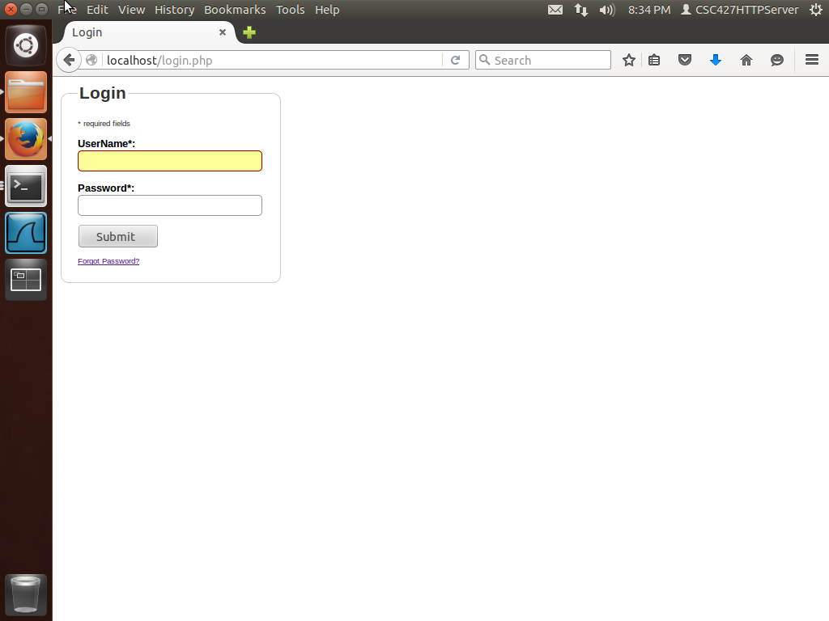

Slide 14
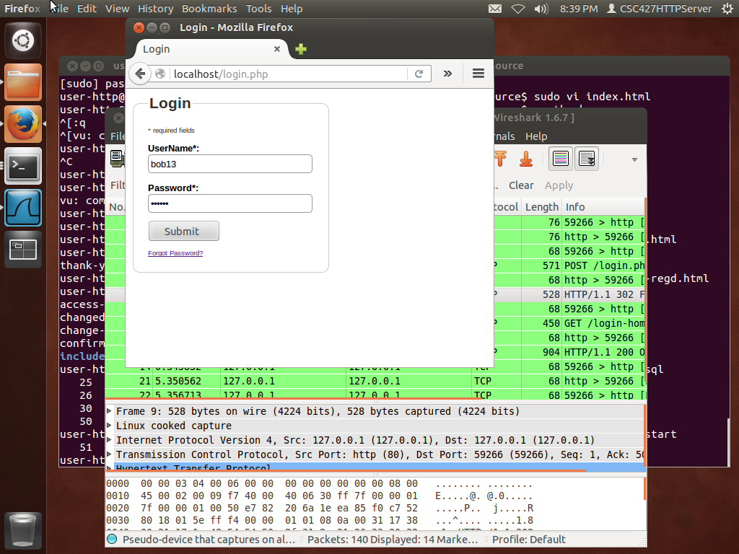
Notes:
<number>

Slide 15
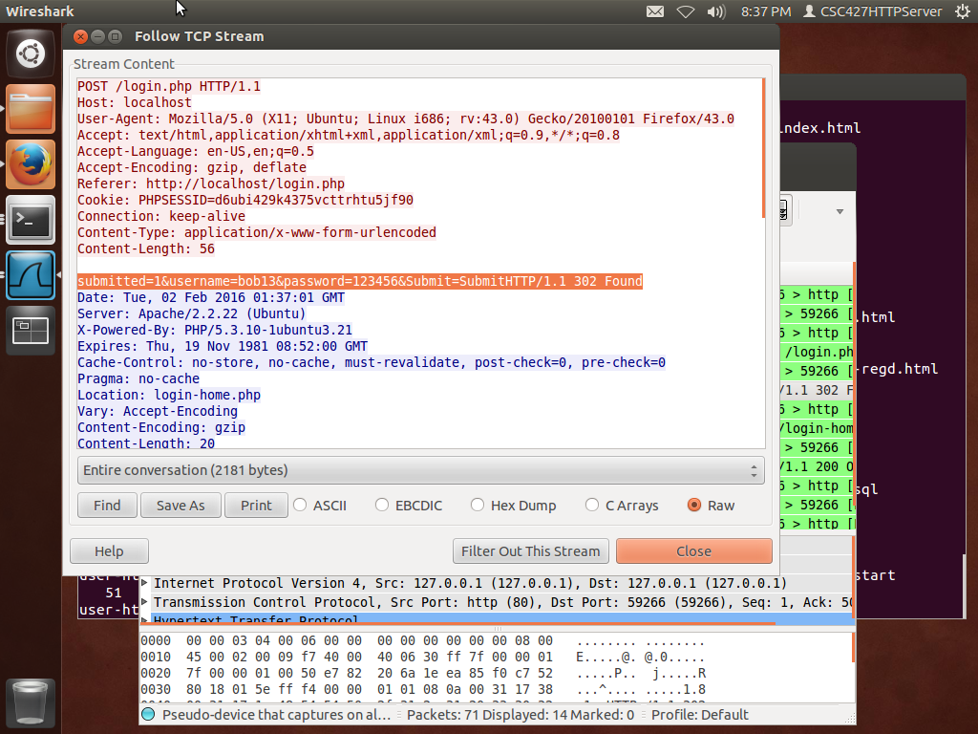

Slide 16
Why is this an issue?
Just under 71.3 million webservers running HTTP
If any website is running HTTP without encryption your data can be stolen
69.9% of the Internet’s 143,909 most popular websites use insecure transfer protocols

Slide 17
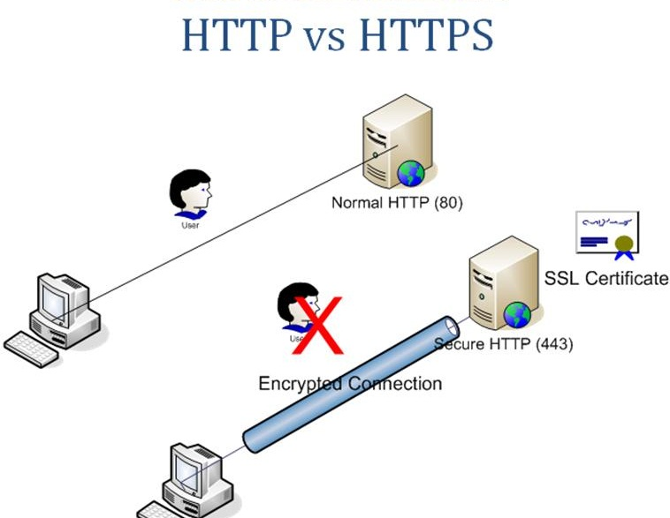
How can HTTP be made more Secure?
Sensitive information should be encrypted before being sent to server
HTTPS can be used to do this

Slide 18
What Is HTTPS?
Hypertext Transfer Protocol over TLS/SSL
Used for secure communication
Consists of communication over Transport Layer Security or the Secure Sockets Layer
Provides authentication of webserver with client
  Is meant to protect against man-in-middle attacks
Provides bidirectional encryption between client and server
Provides a reasonable guarantee that one is communicating with the correct website
Notes:
Hypertext Transfer Protocol over TLS/SSL
is not a different protocol
Used for secure communication
Consists of communication over Transport Layer Security or the Secure Sockets Layer
Provides authentication of webserver with client
Is meant to protect against man-in-middle attacks
Provides bidirectional encryption between client and server
which protects against eavesdropping and tampering with and/or forging the contents of the communication
Provides a reasonable guarantee that one is communicating with correct website
not communicating with a imposter website it makes DNS spoofing harder since the packets are encrypted
Historically, HTTPS connections were primarily used for payment transactions on the web, email, and sensitive transactions in corporate information systems
More recently, it’s used to for all websites securing account info
<number>

Slide 19
How Does HTTPS work?
Is similar to how HTTP works
Main idea is the same HTTP but requests/responses are encrypted
  Messages are then decrypted upon arrival
Is based off of certificates
Webserver must be setup to accept HTTPS connections
  Admin must create a public key certificate
Notes:
Is similar to how HTTP works
Main idea is the same HTTP but requests/responses are encrypted
Messages are then decrypted upon arrival
Everything is encrypted even the headers, and the request/response load
Is based off of certificates
certificate authorities come pre-installed by trusted web browsers to provide valid certificates
A user should only trust a website if and only if the following is true:
User trusts that the browser software correctly implements HTTPS with correctly pre-installed certificate authorities
User trusts the certificate authority to vouch only for legitimate websites
website provides a valid certificate, which means it was signed by a trusted authority
certificate correctly identifies the website (site is not being spoofed)
user trusts that the protocol’s encryption layer (SSL/TLS) is secure against eavesdroppers
Webserver must be setup to accept HTTPS connections
Admin must create a public key certificate
This certificate must also be signed by trusted certificate authority for the web browser to accept it without warning
Certificate Authority then certifies the holder is the operator of the web server that presents it
Web browsers are generally distributed with a list of signing certificates of major certificate authorities so they can verify certificates signed by them
<number>

Slide 20
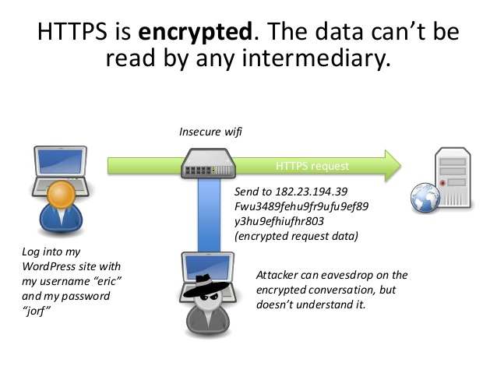

Slide 21
HTTPS GET Example
Notes:
openssl s_client -connect localhost:443
GET /index.html HTTP/1.1
HOST: localhost
<number>

Slide 22
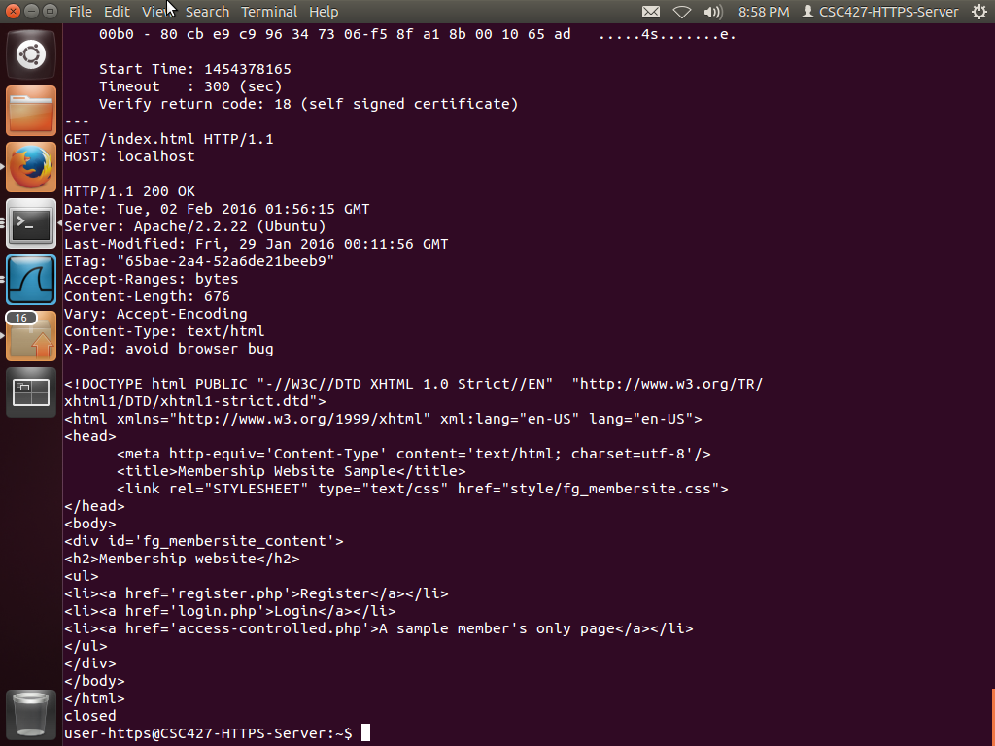
Notes:
<number>

Slide 23
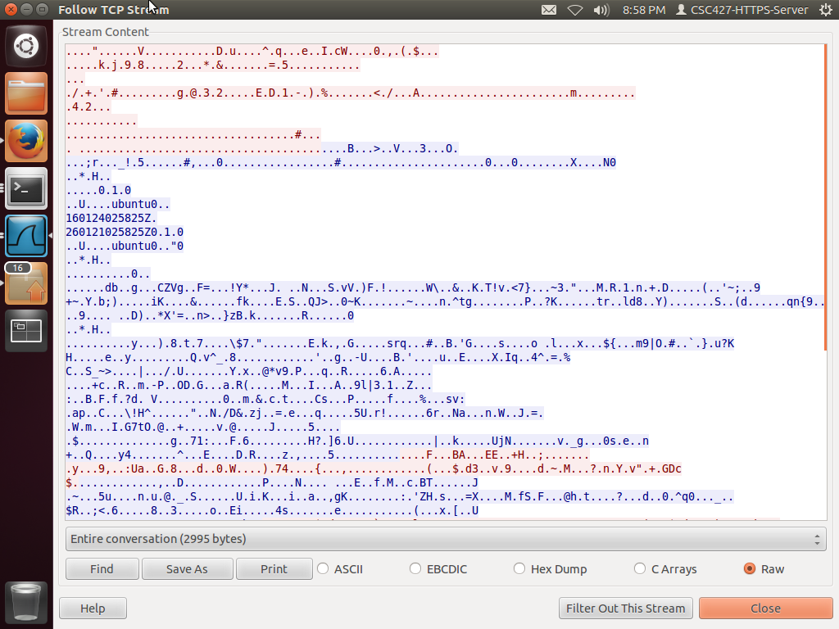
Notes:
<number>

Slide 24

Secure Sockets Layer
Industry standard for establishing a secure connection between two points
Used by millions of websites
Requires an SSL Certificate
Public Key and Private Keys
Uses explicit connections
Notes:
Industry standard for establishing a secure connection between two points
-encrypts the traffic that passes between them
-in theory, SSL is supposed to protect data passed between a webserver and a browser from being accessed or intercepted
Used by millions of websites
in the protection of online transactions
Requires an SSL Certificate
-To be able to create an SSL connection a web server requires an SSL Certificate
-A webserver admin will be prompted to complete a number of questions about identity of your website/company
-Web browsers provide them a key indicator to let them know they are protected by an SSL encrypted session
-user can then view these certiticates
-SSL Certificate will contain the domain name, company name, address, city, state/province, country, expiration date of Certificate, and details of the certification authority responsy for your instance
-When browser connects to a secure site it will retrieve the site’s SSL certificate and check that it is not expired, it has been issued by an Authority it trusts, and that it is being used by the website it was issued for. If it fails one of these checks, the browser disaplys a warning to user letting them know site is not secured by SSL
-webserver also creates two cryptographic keys – Private Key and Public Key
Public Key and Private Keys
-does not need to be secret and is placed into a Certificate signing Request – which is a data file containing your details
-Your webserver will match your issues SSL Certificate to your Private Key. Your web server will then be able to establish an encrypted link between the website and your customer’s web browser
Uses explicit connections
-Connects by port, or explicit connection to a port that expects the session to start with security negotiation
<number>

Slide 25
Transport Layer Security
The successor to SSL
Similar to SSL
Protocol that ensures privacy between users and the communicating applications
Uses implicit connections
Notes:
Is the successor to SSL
Similar to SSL
-It’s basically SSL but more secure because all version of SSL are vulnerable to the POODLE attack
-SSL is effectively dead
-TLS uses stronger cipers
Protocol that ensures privacy between users and the communicating applications
When a server and client communicate, TLS ensures that no third party may eavesdrop or tamper with any messages
-provides data integrity between two communicating computer applications
Uses implicit connections
-by protocol connection where the program will connect “insecurely” first and use special commands to enable encryption (implicit)
<number>

Slide 26
HTTP Vs HTTPS
71.3 million HTTPS vs 29.3 million HTTPS webservers
  Used Shodan, not all websites
HTTPS is relatively secure since data is encrypted
HTTPS cannot be deployed on virtual hosts
Due to the design of HTTPS, webservers may get performance hits
HTTPS URLs begin with “https://” and use port 443
  HTTP uses “http://” and use port 80
Notes:
Can only use HTTPS on a server where you have complete and sole control over the IP address, since the client first looks up the ip address, then requests the secure protocol, and only then makes the HTTP query
Later encryption requires computing resources, so that if you have millions of connections you may feel quite a hit on your server performance
Even with the potential of these above issues, HTTPS should still be your fist choice
<number>

Slide 27
SSL Vulnerabilities
CCS Injection
  Man-in-middle attack, attacker is able to decrypt and modify traffic in transit
HTTPS Bicycle Attack
  Allows attackers to reveal length of unknowns
ClientHello sigalgs DoS
  Allows an attacker to read a certificate and modify it causing the certificate to crash a client or server
Notes:
Now that you think HTTPS is perfectly secure, there are still exploits involved where attackers can still grab information you think is secured
These are just some of the issues with SSL, there are many others
<number>

Slide 28

Heartbleed Attack
Reported April 1st 2014
  Fixed April 7th 2014
Caused by the Heartbeat Extension
A flaw in OpenSSL
Allows attackers to steal encryption keys,
user passwords, and site content
Notes:
The Heartbeat Extension was supposed to provide a new protocol for TLS allowing the usage of keep-alive functionality without performing a renegotiation and a basis for MTU path discovery
Flaw in OpenSSL software which many sites use to encrypt and transmit data
Allows attackers to steal encryption keys, user passwords, and site content
-Allows anyone on the internet get into a secure Web server running certain versions of OpenSSL
-Once an attacker has a website’s encryption keys, anything is fair game
<number>

Slide 29
Heartbleed Attack
Not traceable
Top sites that could have been compromised:
  Facebook, Google, Wikipedia, Amazon, Twitter, Apple, and Microsoft
Estimated 17% of websites affected
OpenSSL versions 1.0.1 – 1.0.1f
  Default encryption for Apache
Notes:
Not traceable
-This bug would leave no trace and potential damage from an attack would be so significate all websites ever used an affected version of OpenSSL would be considered compromised
Top sites that could have been compromised:
Facebook, Google, Wikipedia, Amazon, Twitter, Apple, and Microsoft
-although they are not currently vulnerable, they may have been in the past
- estimated
Estimated 17% of websites affected
-About half a million “secure” websites certified by trusted authorities were believed to be vulnerable
OpenSSL versions 1.0.1 – 1.0.1f
Default encryption for Apache
<number>

Slide 30
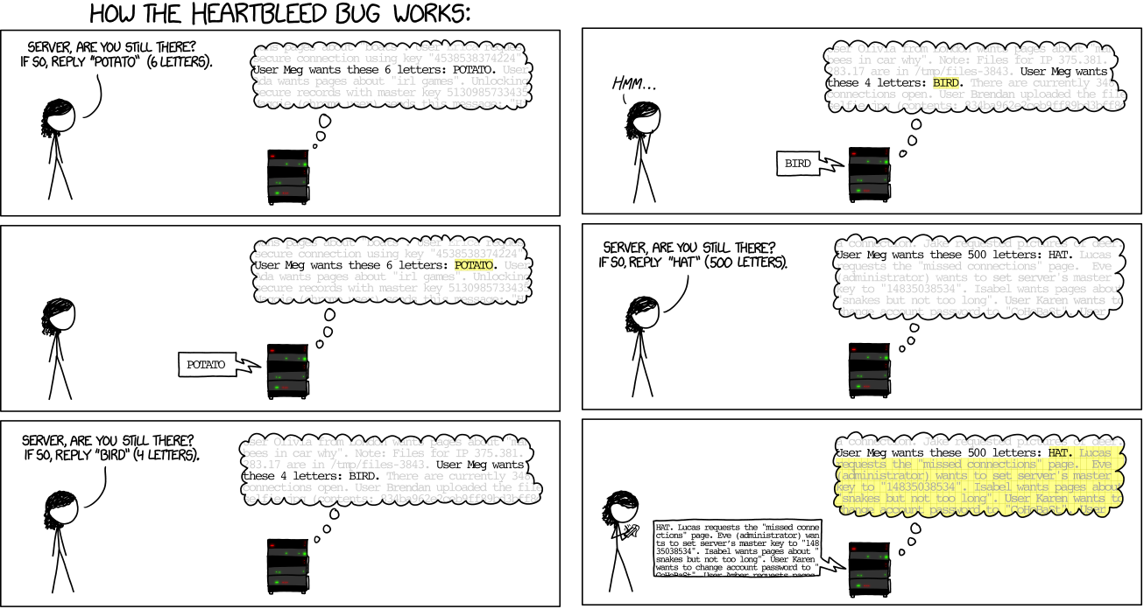
Heartbleed Attack Explanation

Slide 31
Heartbleed Attack Explanation
Heartbeat Extension requires the receiver to send the exact same payload back to sender
Affected OpenSSL versions returns a message based on length field of requesting message
This is exploited by an attacker sending small payloads and large length fields
Notes:
Bug’s name refers to a handshake in OpenSSL’s code called the heartbeat extension, which sets a limit on how long an encrypted session stays valid. A coding error meant that the extension was missing a necessary verification, giving an attacker access to additional information about the server and creating the vulnerablility
Heartbeat Extension requires the receiver to send the exact same payload back to sender
-allows one computer at one end of a connection to send a “heartbeat request” message, consisting of a payload typically a text string along with the payload’s length as a 16 bit integer
-receiving computer then must send exactly same payload back to sender
Affected OpenSSL version returns a message based on length field of requesting message
-affected versions of OpenSSL allocate a memory buffer for the message to be returned based on the length field in the requesting method, without regard to the actual size of that message’s payload. Because of this, failure to do proper bounds checking, the message returned consists of the payload, possible followed by whatever else happened to be in the allocated memory buffer
This is exploited by an attacker sending small payloads and large length fields
-permits attackers to read up to 65kb of victim’s memory that was likely to been used previously by OpenSSL
-but the attacker cannot choose what content is revealed
<number>

Slide 32
Heartbleed Demo
Notes:
<number>

Slide 33
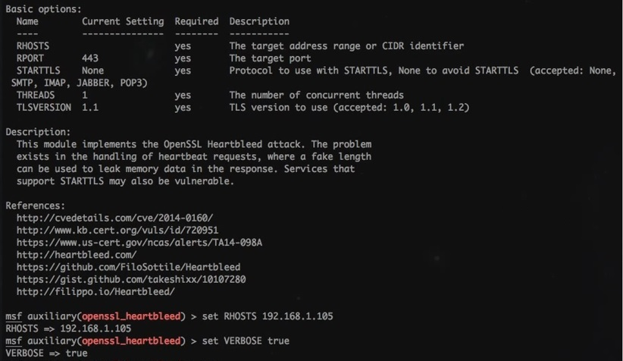

Slide 34
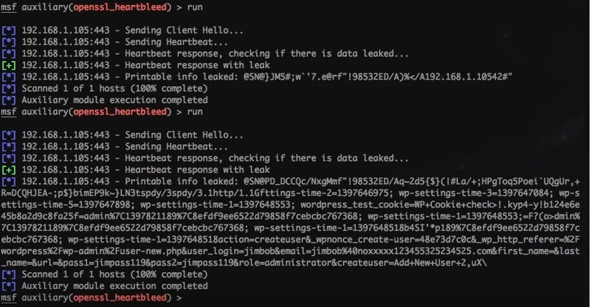

Slide 35
Heartbleed in Action
Attack on Canada Revenue Agency
Attackers stole security keys from Community Health Systems
Since attack was untraceable, many other unknown attacks were made
Notes:
Attack on Canada Revenue Agency
-they reported a theft of social insurance numbers belonging to 900 tax payers
-said that they were accessed through exploit of the bug during a 6 hour period
-after discovery of attack, agency shut down its website
-provided anyone affected with credit protection at no cost
Attackers stole security keys from Community Health Systems
-second biggest for-profit U.S. hospital chain in the US, compromising the confidentiality of 4.5 million records
<number>

Slide 36
Heartbleed Fixed
Fixed in OpenSSL 1.0.1g
  Added bounds check
Fixed with a simple piece of code
If (1 + 2 + payload + 16 > s->s3->rrec.length) return 0;
Notes:
Fixed in OpenSSL 1.0.1g
Added bounds check
-prevents the buffer over read
Fixed with a simple piece of code
If (1 + 2 + payload + 16 > s->s3->rrec.length) return 0;
This discards the Heartbeat request preventing a reply from being constructed if it would trigger the heartbleed bug
<number>

Slide 37
Bicycle Attack Demo
Notes:
1) Obtain a packet capture (i.e. via a Man-in-the-Middle attack) which has stream-cipher TLS traffic of encrypted browser requests to a known website, including one where there was likely to be a password sent in an authentication request. The target site may be revealed in the packet capture in the form of a DNS request, or the attacker may be able to find this out with some reconnaissance.
2) Obtain a "User-Agent" string from the packet capture or determine which browser the target was using.
3) Replicate browser requests to the site using the same browser as determined in (2). This will reveal the lengths of the requests to various pages on the site.
4) From the encrypted TLS payloads of the browser requests in the packet capture, extract the lengths of the payloads.
5) Compare the Pearson correlation coefficient for the plain-text and encrypted requests. This will enable us to compare plain-text and encrypted request lengths in order to reveal which encrypted TLS requests are for which pages (URLs) of the website.
6) From (5) you should now know which TLS encrypted request is for the login page of the website. You can then subtract the length of the known headers that the browser would send to this page, including any possible cookies that are static enough in length to be determined. Also subtract the length of the posted or queried data containing the user's username that we already know, and anything else that is possible to pre-determine in the request.
7) The length you end up with should be the length of the user's password
<number>

Slide 38
HTTPS Bicycle Attack
Affects TLS
Basic idea, this attack allows an attacker to figure out length of secret data
Is undetectable by user
Is a type of man-in-the-middle attack
  Attacker only needs to capture HTTPS traffic
Requires TLS traffic must be using a stream oriented cipher
  Specific type of encryption
Notes:
<number>

Slide 39
Why is finding the password Length Useful?
Attacker has an easier job figuring out the password if he knows the length
If attacker knows which combination characters are required

Slide 40
How can these issues be solved
User End
  Having a strong password would make cracking it hard
  Two factor authentication
Website Operators
  Turn off TLS stream-ciphers
  Ensure the newest version of TLS is supported
Developers:
  Ensure secret information is padded or hashed to a fixed length

Slide 41
What can we learn from this
Always use HTTPS over HTTP
Even if you think you have a secure connection this may not always be the case
Notes:
Always use HTTPS over HTTP
-some encryption is better than no encryption
Even if you think you have a secure connection this may not always be the case
-just be smart what you’re doing on the internet
<number>

Slide 42
Sources
HTTP:
https://www.w3.org/Protocols/HTTP/1.1/rfc2616bis/draft-lafon-rfc2616bis-03.html
ftp://ftp.isi.edu/in-notes/rfc2616.pdf
http://www.tutorialspoint.com/http/http_security.htm
HTTPS:
https://tools.ietf.org/html/rfc2818
HTTP VS HTTPS:
https://www.instantssl.com/ssl-certificate-products/https.html
http://www.biztechmagazine.com/article/2007/07/http-vs-https
Setting up apache on Ubuntu HTTP (These instructions have info for setting up HTTPS as well):
https://help.ubuntu.com/lts/serverguide/httpd.html
Setting up apache with GCM-based ciphersuite:
https://www.digicert.com/ssl-support/ssl-enabling-perfect-forward-secrecy.htm

Slide 43
Sources
HTTP Security concerns:
https://www.w3.org/Protocols/rfc2616/rfc2616-sec15.html
HTTP WireShark:
https://samsclass.info/120/proj/p3-wireshark.htm
MySQL:
https://help.ubuntu.com/lts/serverguide/mysql.html
https://www.digitalocean.com/community/tutorials/a-basic-mysql-tutorial
Registration Form:
http://www.html-form-guide.com/php-form/php-registration-form.html
Heartbleed:
https://asecuritysite.com/encryption/heart2
https://alexandreborgesbrazil.files.wordpress.com/2014/04/hearbleed_attack_version_a_1.pdf
http://way2hacker.blogspot.ca/2014/04/how-to-exploit-heartbleed-extension.html
http://hackercool.com/2015/08/httpwp-mep6mnvu-yk/
https://www.youtube.com/watch?v=QJ4t1qP4xvw

Slide 44
Sources
SSL:
http://info.ssl.com/article.aspx?id=10241
TLS:
http://searchsecurity.techtarget.com/definition/Transport-Layer-Security-TLS
https://luxsci.com/blog/ssl-versus-tls-whats-the-difference.html
Metasploit:
http://www.darkoperator.com/installing-metasploit-in-ubunt/

